Slide 1


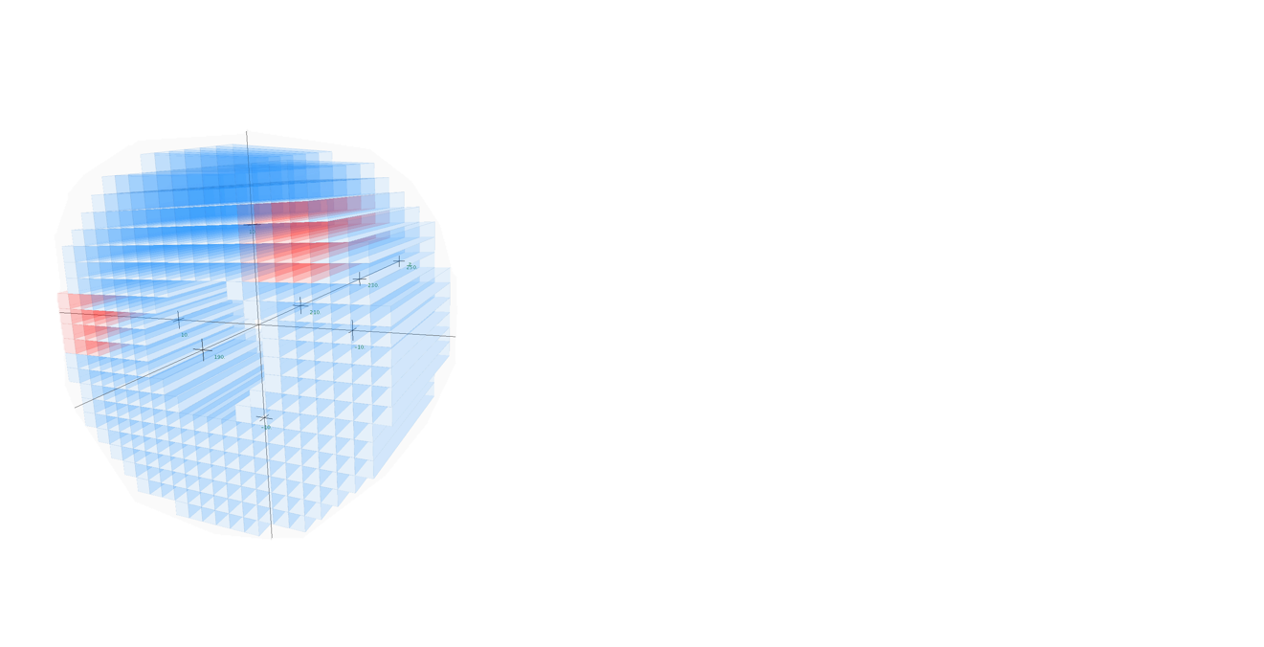
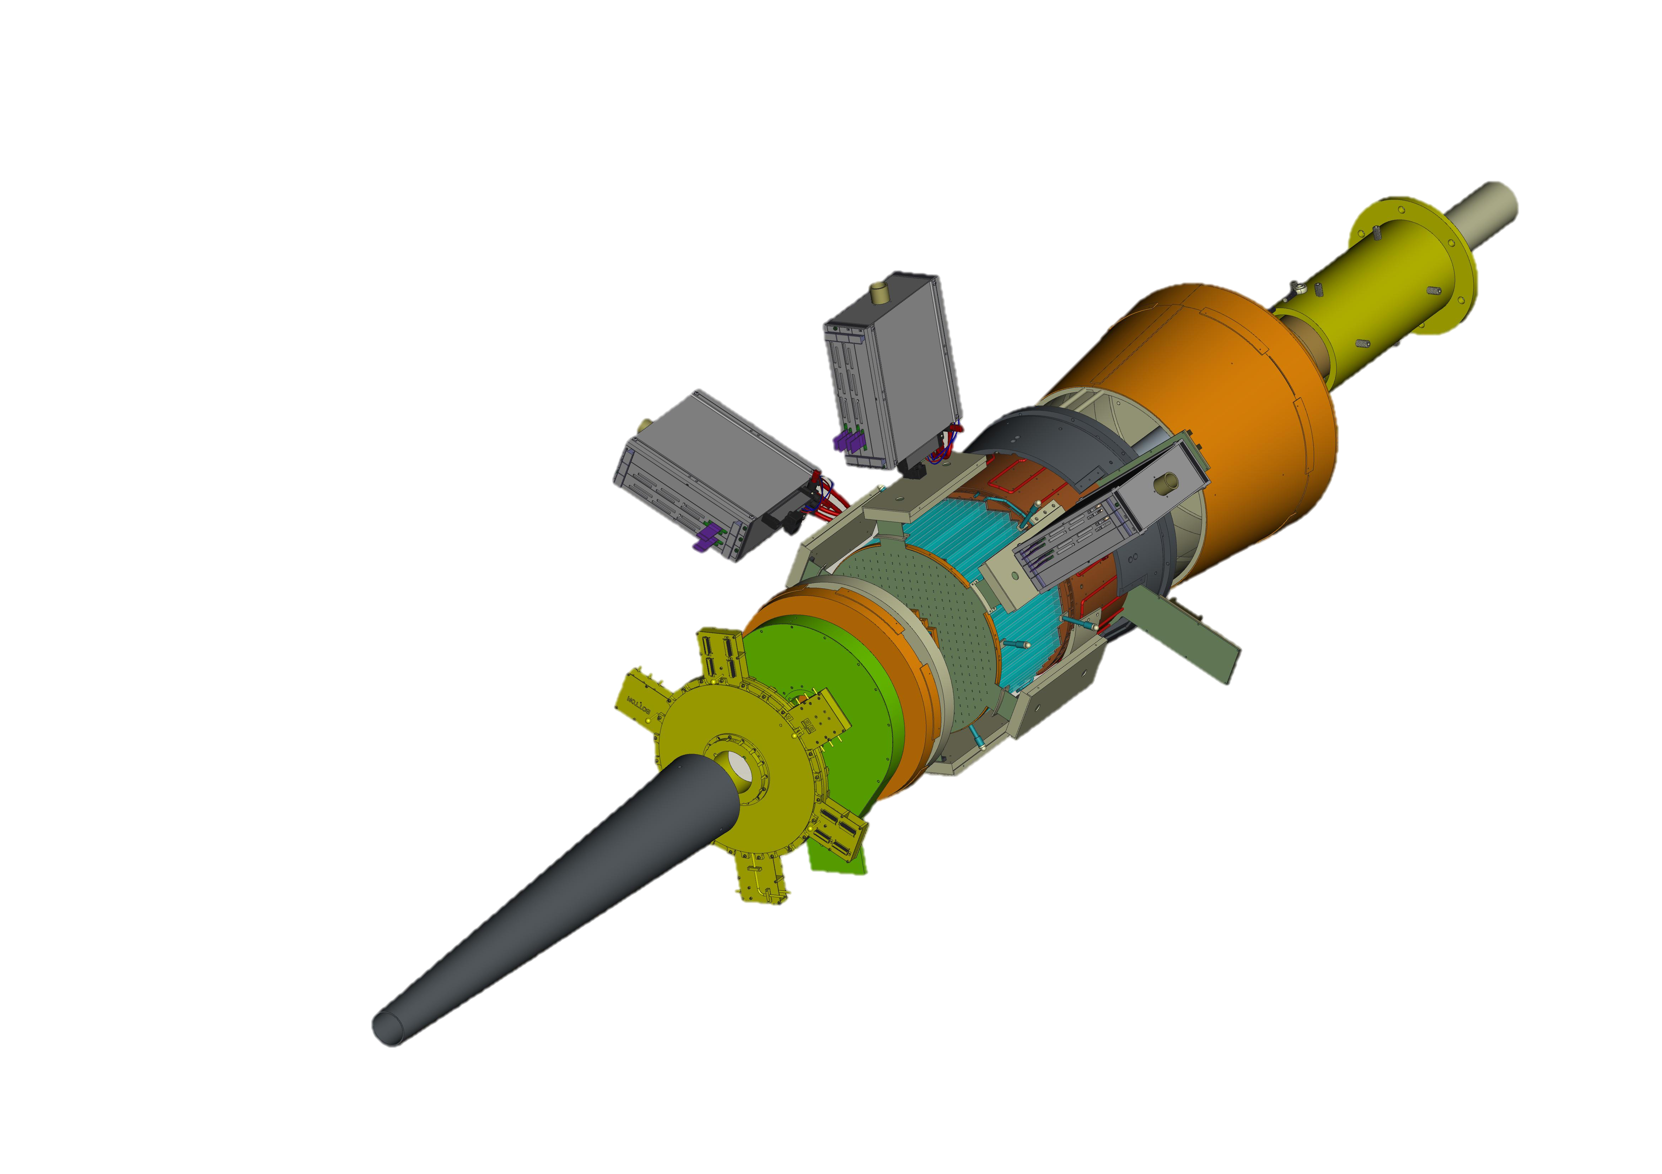

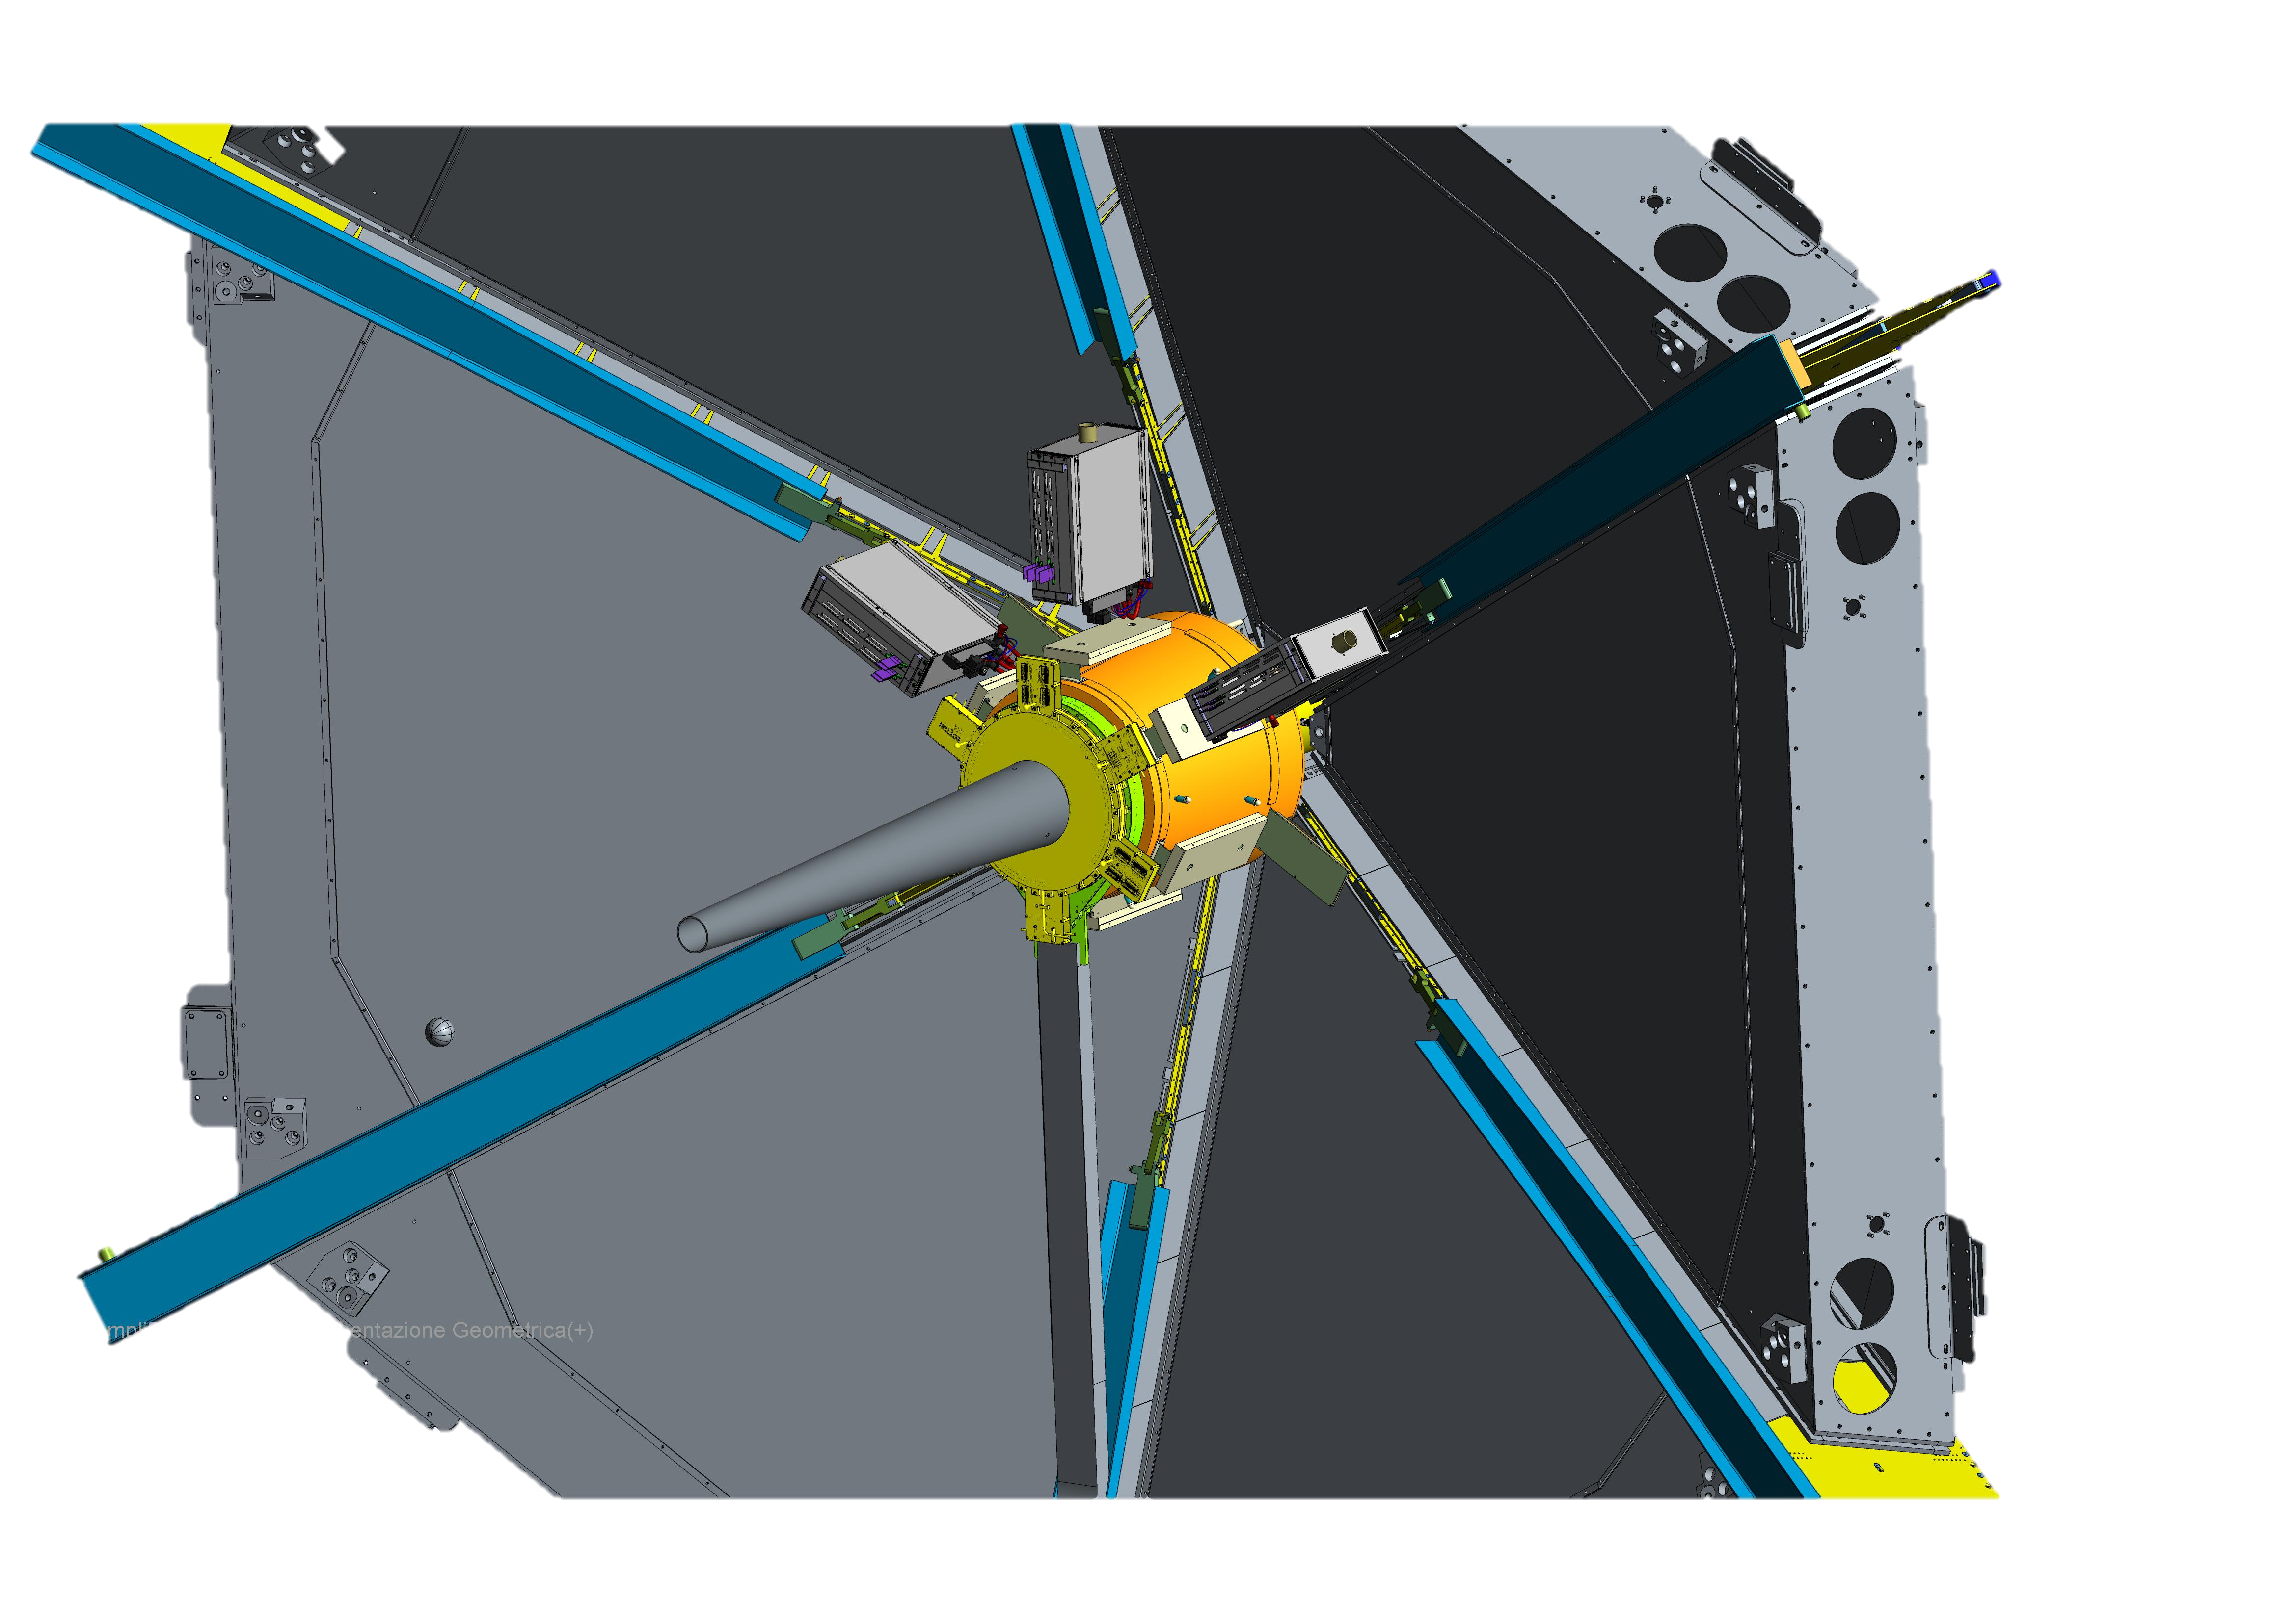
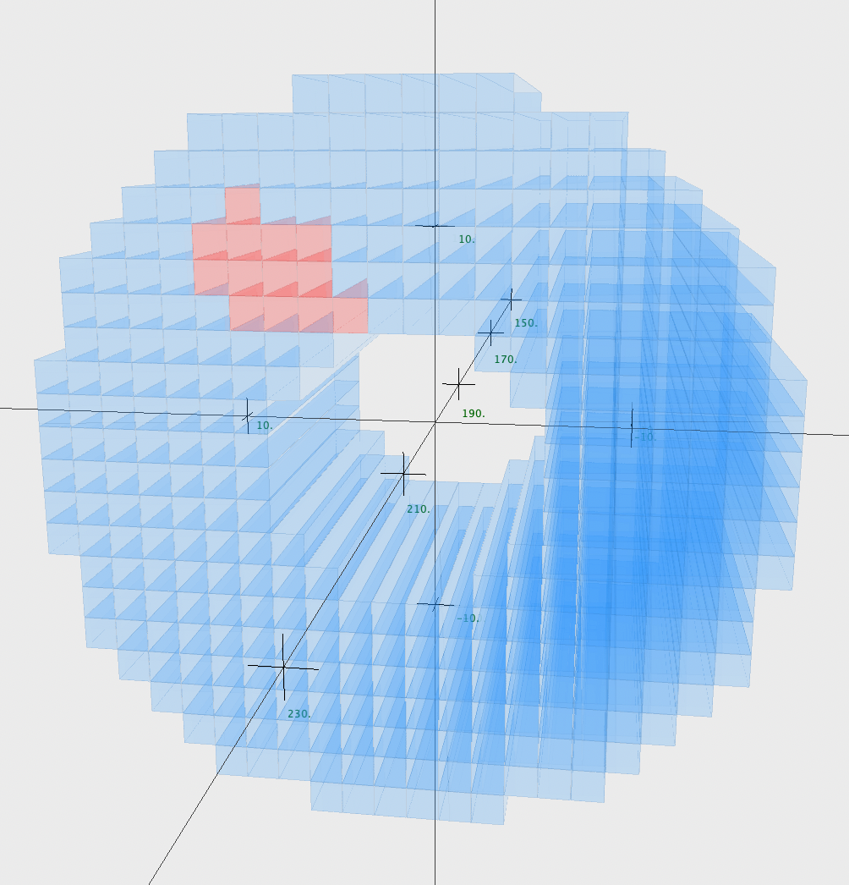
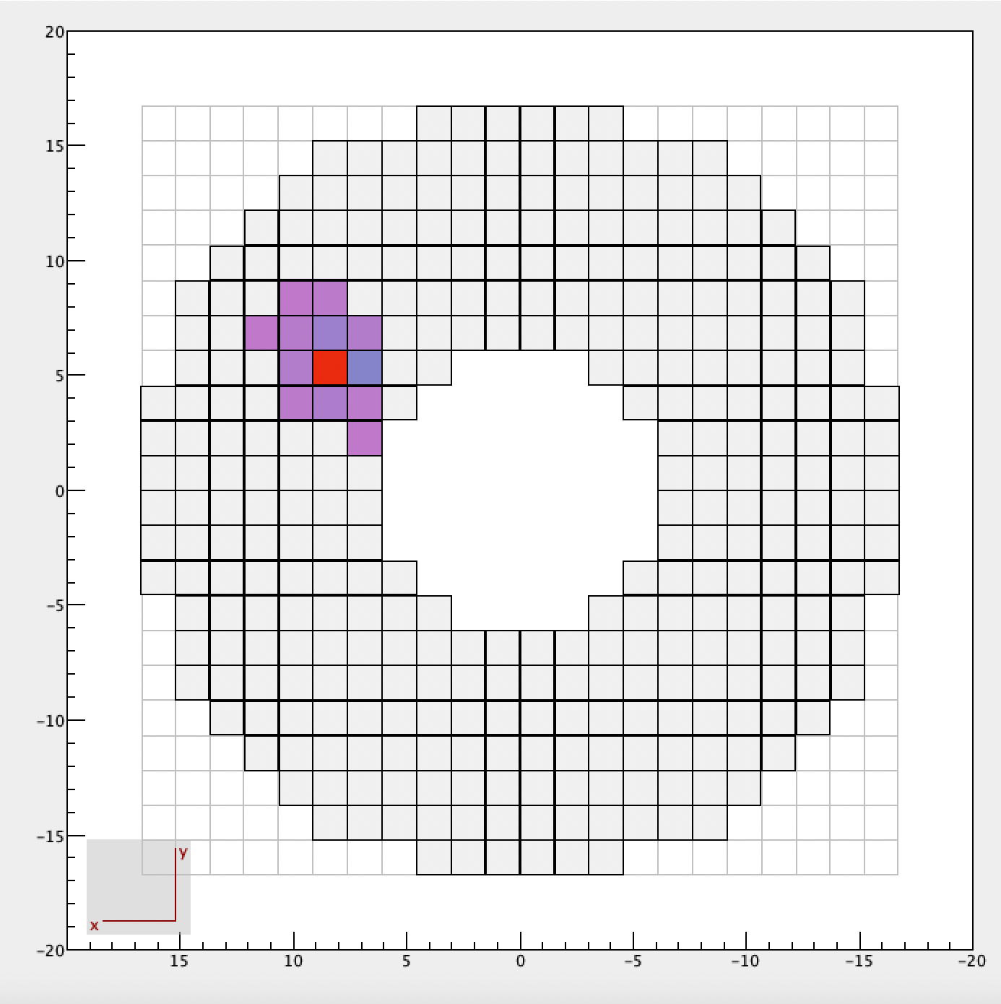
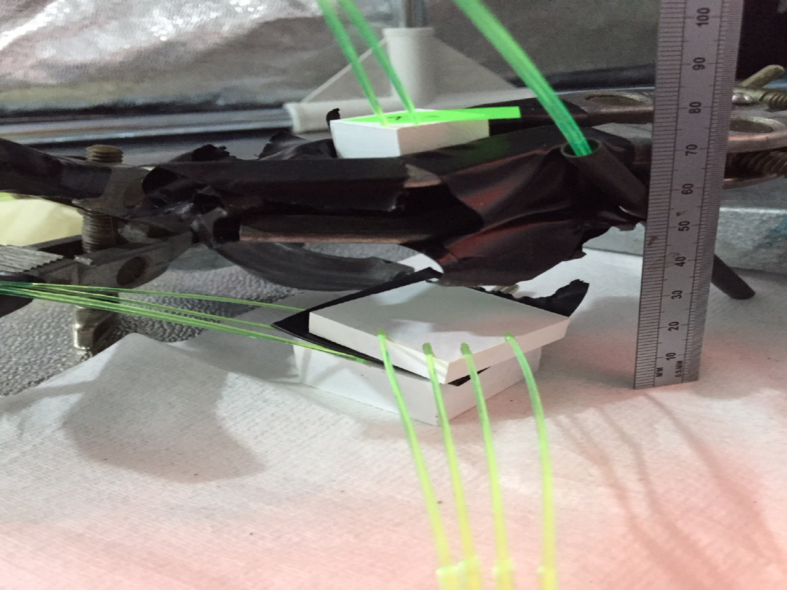
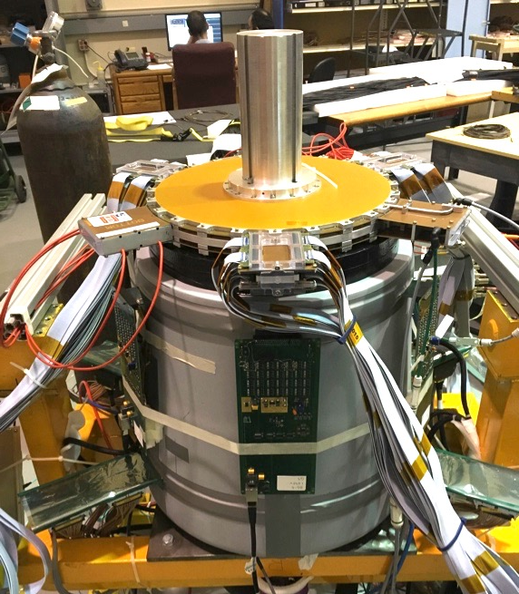
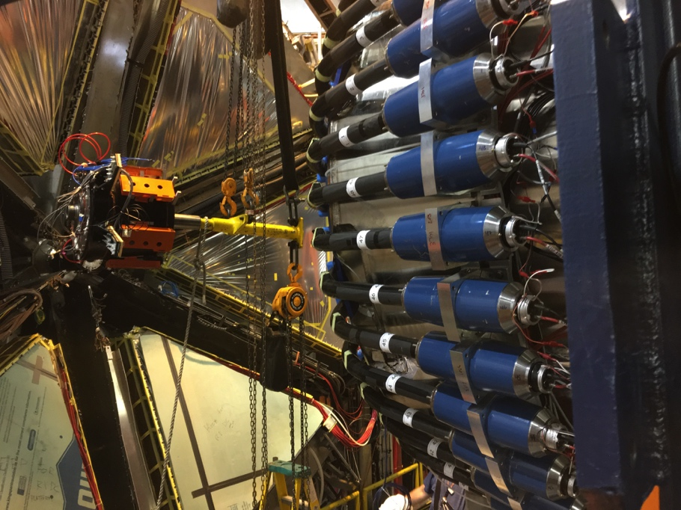
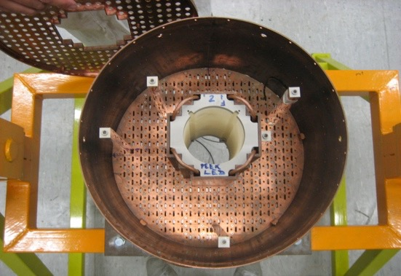
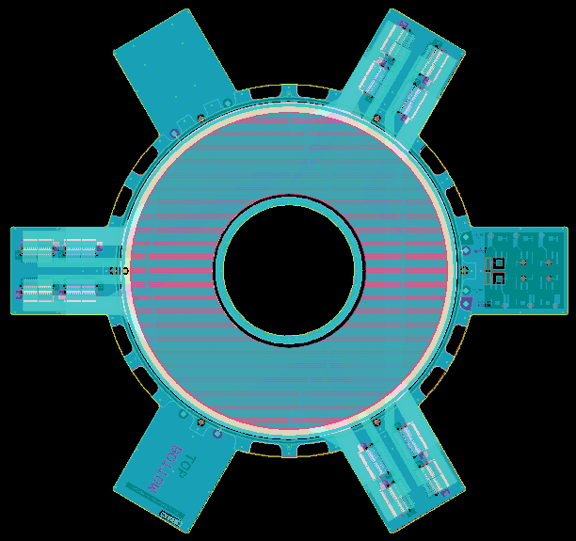
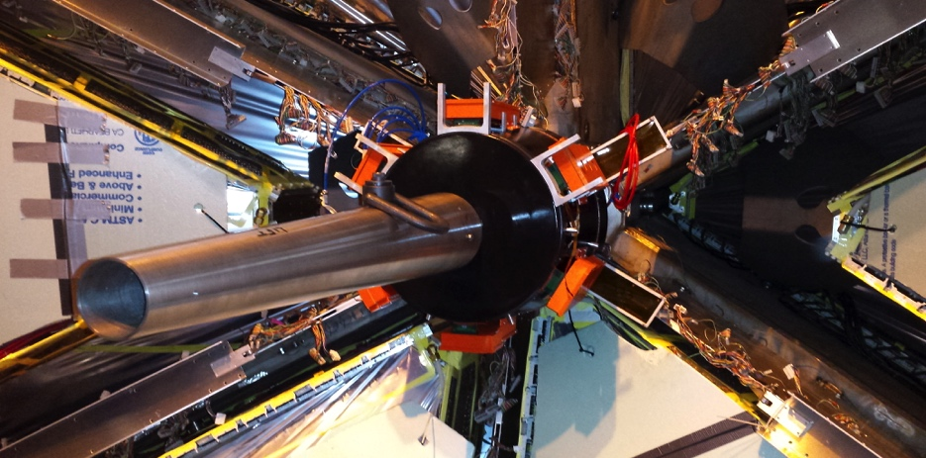
Forward Tagger
Thomas Jefferson National Accelerator Facility
What is it
The CLAS12 Forward Tagger is designed to detect electrons scattered at very small angles (2.5°-4.5°)
Three detector systems based on three technologies
In this kinematics, the electron beam is equivalent to a photon beam, which is ideal to study hadron spectroscopy and investigate fundamental questions on the origin of mass
Lead-tungstate scintillator calorimeter to determine the electron energy
Plastic scintillator hodoscope to distinguish electrons from photons
Micromegas tracker to determine the electron impact point
Did you know?
Forward Tagger In Action
With a weight of ~625 lbs. and a volume less than 3 ft³, the Forward Tagger is the highest density detector in CLAS12
The calorimeter is operated at 0 C or 32 F because the light yield of the scintillating crystals is higher than at room temperature and the detector resolution improves. This is true for most scintillators but is particularly significant in PbWO.
The detector design was a challenge because of the limited space and accessibility, the high radiation levels, and the magnetic field in the installation location.
The main components of the three detectors were built in Europe and shipped to Jefferson Lab where the Forward Tagger was assembled. The tracker is so small that it was shipped in a suitcase.
Electrons going through the detector deposit energy along their trajectory producing measurable signals in the tracker, hodoscope, and calorimeter
In the calorimeter, electrons produce a so-called electromagnetic shower, i.e. a chain reaction where the electron converts its energy into photons that produce more electrons, and so on
The electromagnetic shower produces signals in multiple adjacent crystals, forming a “cluster”
3D (left) and front (bottom) view of the calorimeter from the CLAS12 event display, showing an electron signal
CAD view of the Forward Tagger mounted in CLAS12
Each “box” corresponds to a crystal. The colored ones are the crystals where a signal is detected.
Building and Installing the Forward Tagger
Tech Specs
Calorimeter:
Lead-tungsten (PbWO) scintillating crystals
332 15x15x200 mm³ crystals
Light detection by large-area avalanche photodiodes (LAAPD)
Hodoscope:
2 layers of plastic scintillator tiles with wavelength-shifting (WLS) fibers
116 plastic scintillator tiles per layer (30x30 mm² and 15x15 mm² tiles)
Optical fibers readout by silicon photomultipliers (SIPM)
Tracker:
2 double-sided Micromegas detectors with X-Y strips
768 strips per layer with 560 µm pitch
Readout electronics based on the DREAM ASIC
Test of the hodoscope tiles after WLS fibers glueing
The full Forward Tagger during cosmic ray tests
The Forward Tagger being lifted for the installation
Contributing Institutions
Istituto Nazionale di Fisica Nucleare (INFN), Italy
CEA – Saclay, Paris, France
University of Edinburgh, Edinburgh, UK
Jefferson Lab. Newport News, VA, USA
James Madison University, Harrisonburg, VA, USA
University of Glasgow, Glasgow, UK
Norfolk State University, Norfolk, VA, USA
Ohio University, Athens, OH, USA
University of York, York, UK
The calorimeter copper thermal shield during the crystal installation
The tracker PCB
The Forward Tagger mounted in the final location

